Slide 1

The Technology Value Stream
By William Egge
Notes:
Our presentation today will delve into the Technology Value Stream, focusing specifically on critical aspects such as the distinction between Lead Time and Processing Time, the typical scenario of elongated deployment lead times, and the aspiration of DevOps to minimize these lead times.

Slide 2
Comprehending Lead Time and Processing Time
Notes:
Lead time stands as one of two key metrics for evaluating performance in value streams in the realm of Lean methodologies. It starts ticking from the moment a request is initiated and concludes when it's completed.

Slide 3
Diving Deeper into Processing Time
Notes:
Contrarily, processing time, another critical metric, begins only when we start acting on a customer's request, excluding any waiting period prior to the actual commencement of work. As a whole, they look like the following diagram.

Slide 4
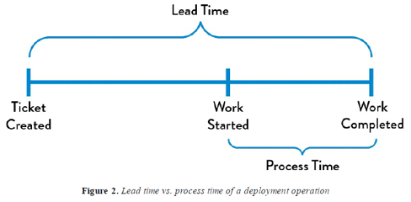
Notes:
Source: Haver, T. (2020). Book Club: The DevOps Handbook (Chapter 1. Agile, Continuous Delivery, and the Three Ways). Red Green Refactor.

Slide 5
The Significance of Lead Time
Notes:
As customers experience lead time firsthand, we place more emphasis on refining it over processing time. Unfortunately, the ratio of processing time to lead time can serve as an effective indicator of operational efficiency.

Slide 6
The Prevalent Scenario
Prolonged Deployment Lead Times
Notes:
Let's transition to a usual predicament many teams and organizations encounter – deployment lead times stretching over months. This scenario is often seen in larger, intricate organizations dealing with monolithic, tightly knit systems.

Slide 7
Navigating the Challenges of the Prevalent Scenario
Notes:
In these circumstances, exceptional efforts are often demanded at virtually every stage of the value stream. It's not uncommon for issues to surface only towards the end of a project when all changes from the development team are integrated.

Slide 8
Repercussions of Extended Deployment Lead Times
Notes:
With extended deployment lead times, remedying each problem can turn into a lengthy, arduous process. This not only impacts productivity but also leads to suboptimal customer experiences.

Slide 9
The DevOps Paradigm
Swift Deployment
Notes:
The DevOps utopia envisions developers receiving immediate, continuous feedback on their tasks. This enables them to promptly implement, corroborate, and validate their code, fostering a seamless deployment into the production environment.

Slide 10
Realizing the DevOps Paradigm
Notes:
To realize this, we make frequent, minor code changes to our version control repository, perform both automated and exploratory testing against it, and ensure its successful deployment into production.

Slide 11
The DevOps Utopian Value Stream
Notes:
In this utopian DevOps environment, our deployment lead time is counted in mere minutes, or hours in a worse case scenario.

Slide 12
Work Cited
Kim, Gene; Humble, Jez; Debois, Patrick; Willis, John; Forsgren, Nicole. The DevOps Handbook (pp. 66-70). IT Revolution Press. Kindle Edition.
Haver, Thomas. "Book Club: The DevOps Handbook (Chapter 1. Agile, Continuous Delivery, and the Three Ways)." Red Green Refactor, 4 Nov. 2020, red-green-refactor.com/2020/11/04/book-club-the-devops-handbook-chapter-1-agile-continuous-delivery-and-the-three-ways/​.

